Slide 1

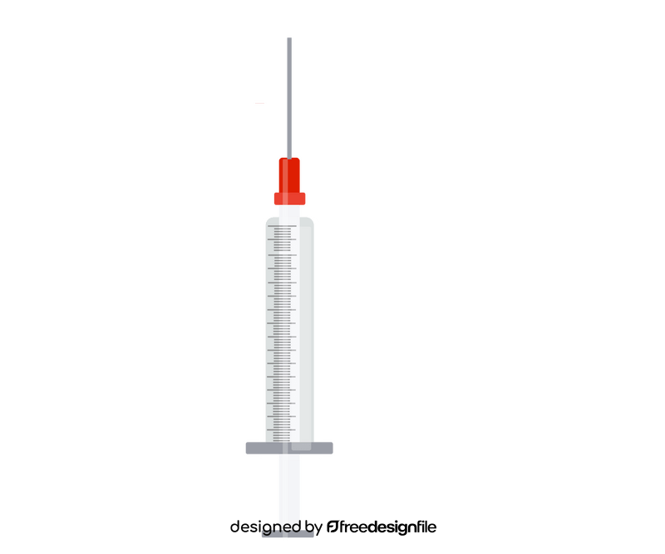

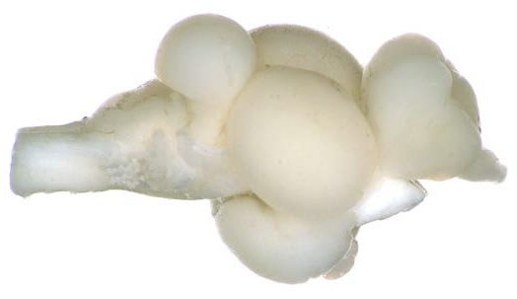
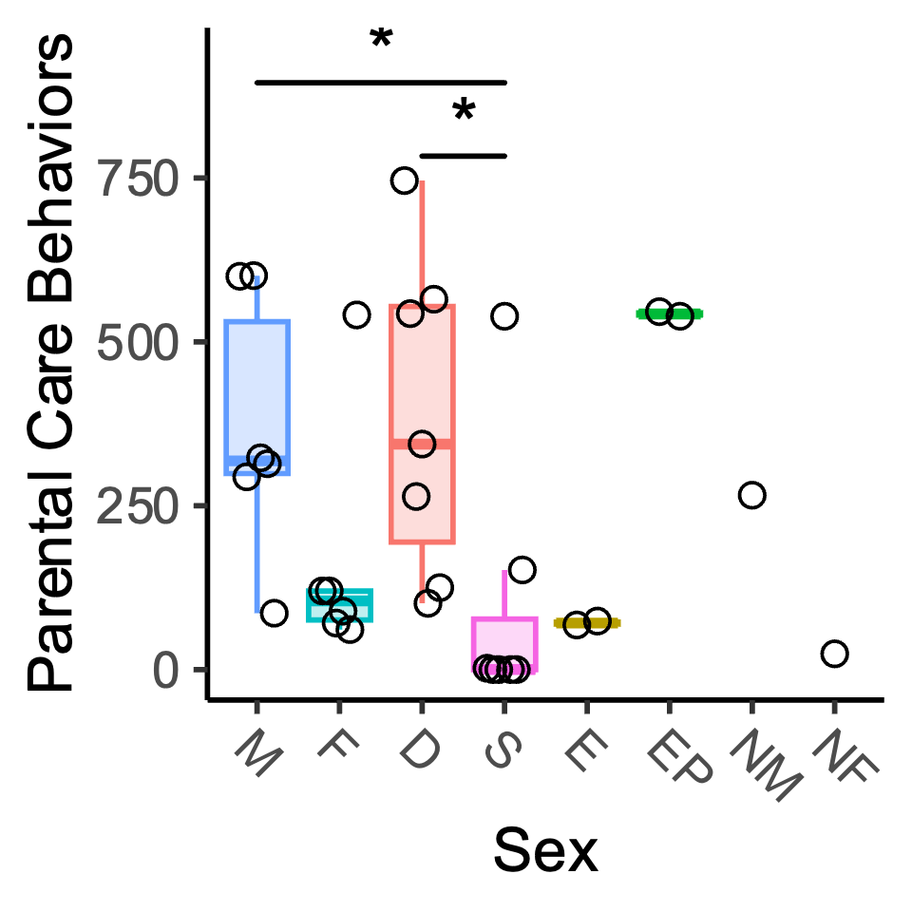
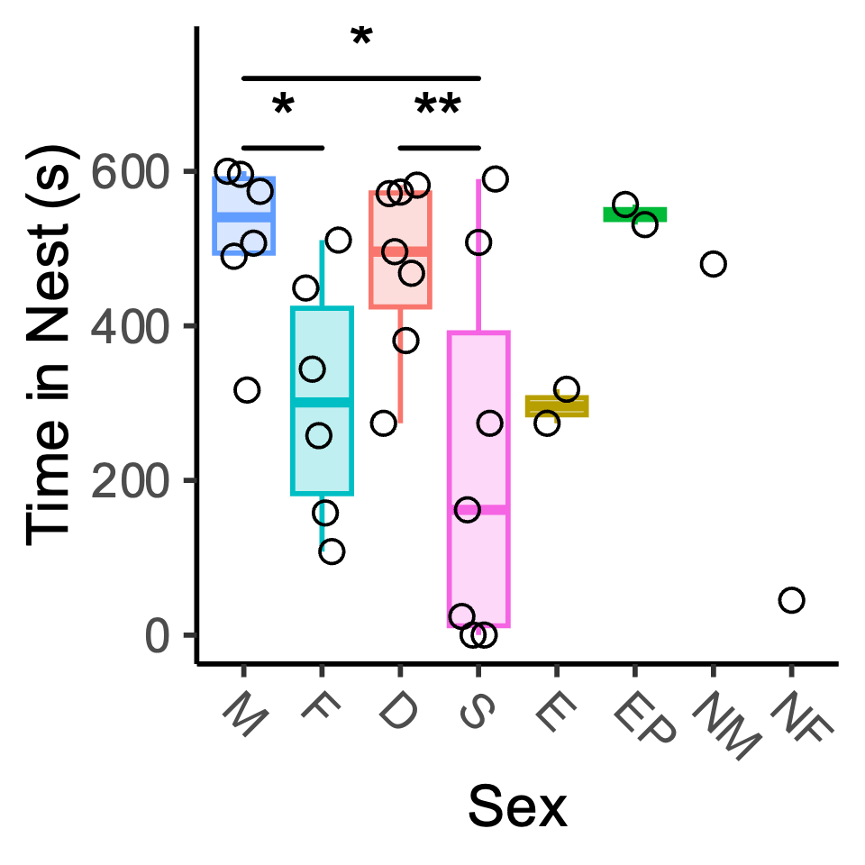
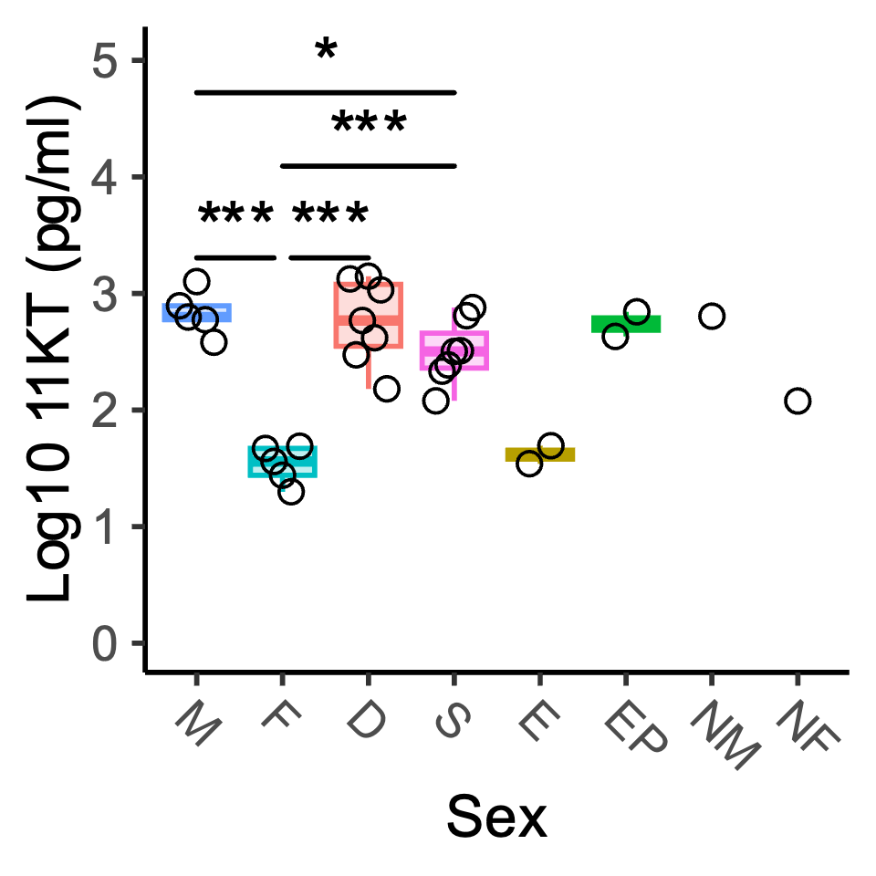
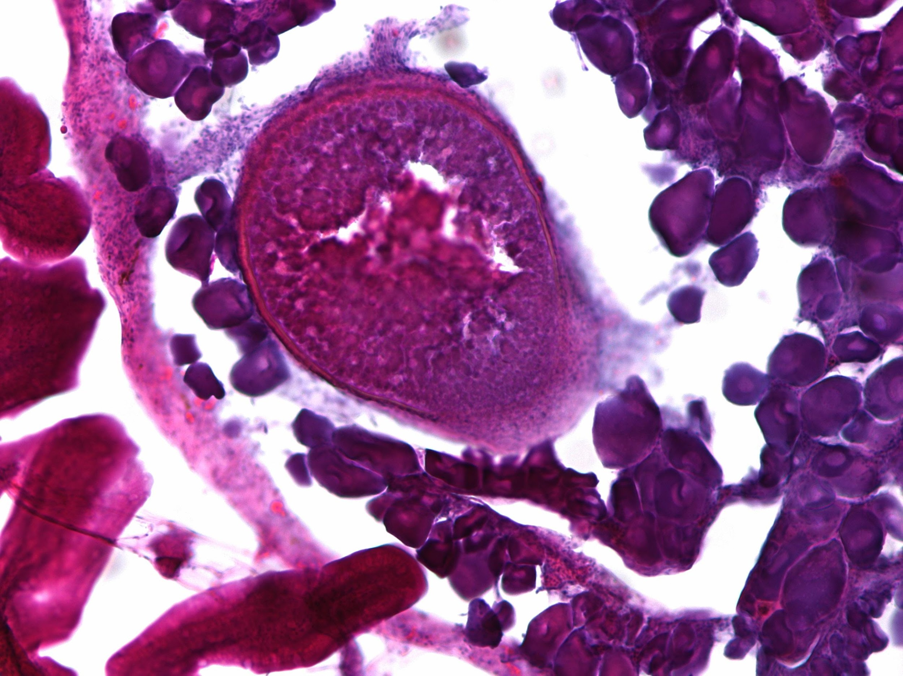
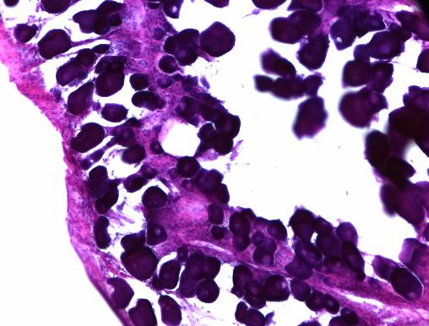
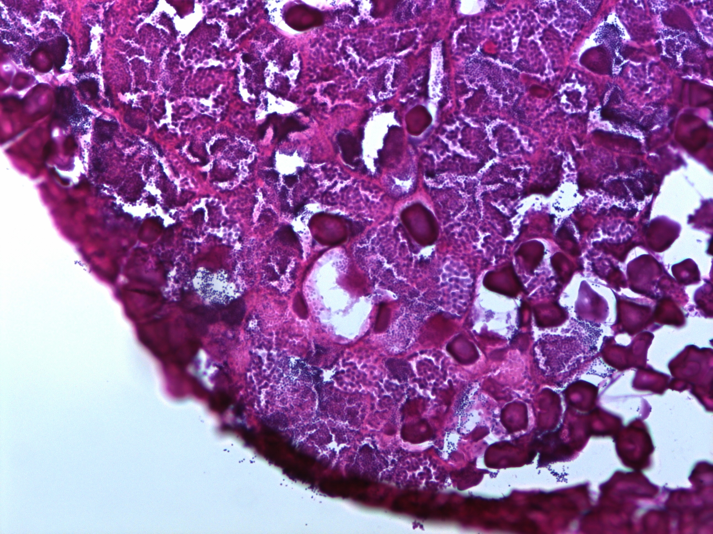
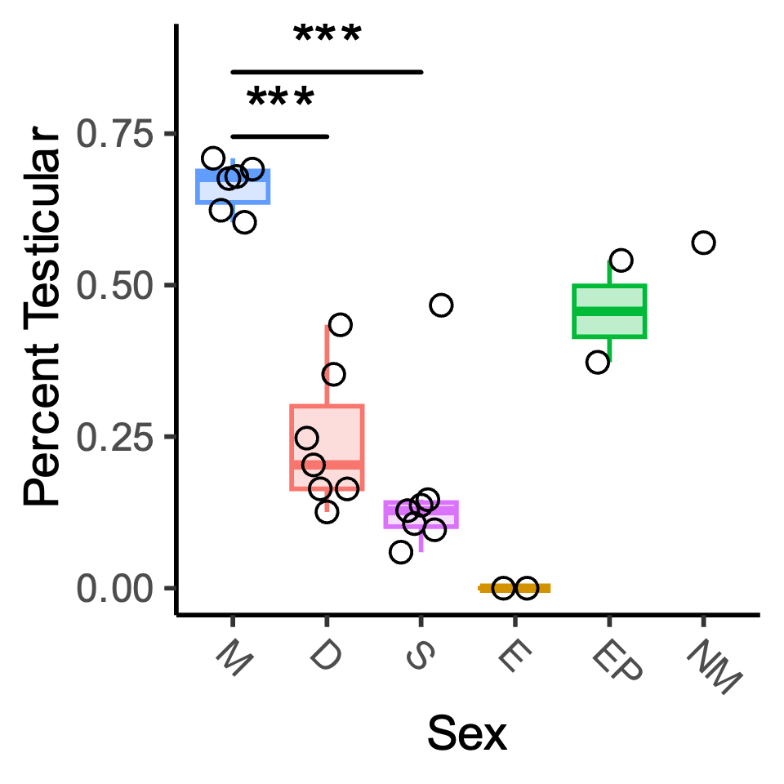
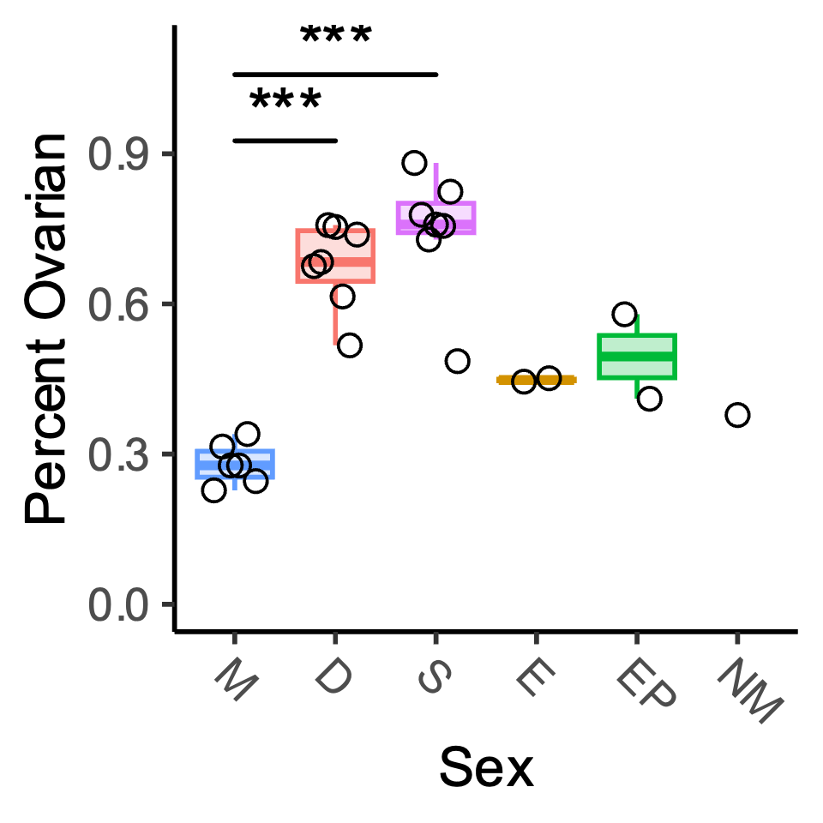
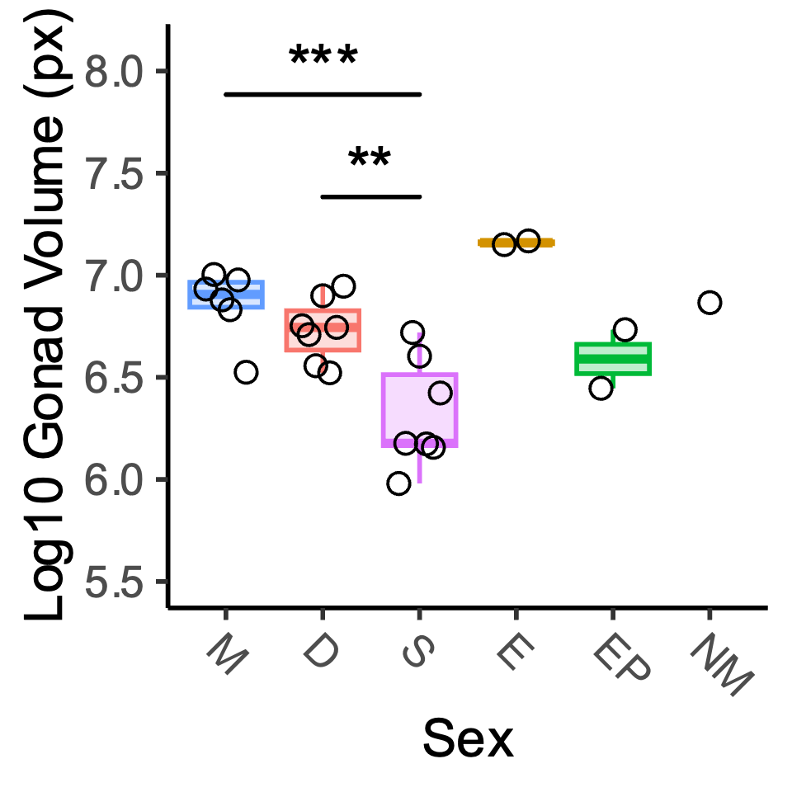
a
♂
♂
♂
D
6 Months
Pairing
n = 10 pairs
Parental Care Assay
D
♂
Dissect out POA for snMultiome
Gonadal Histology
Serum 11KT Analysis
b
c
d
e
f
g
h
i
j

Slide 2
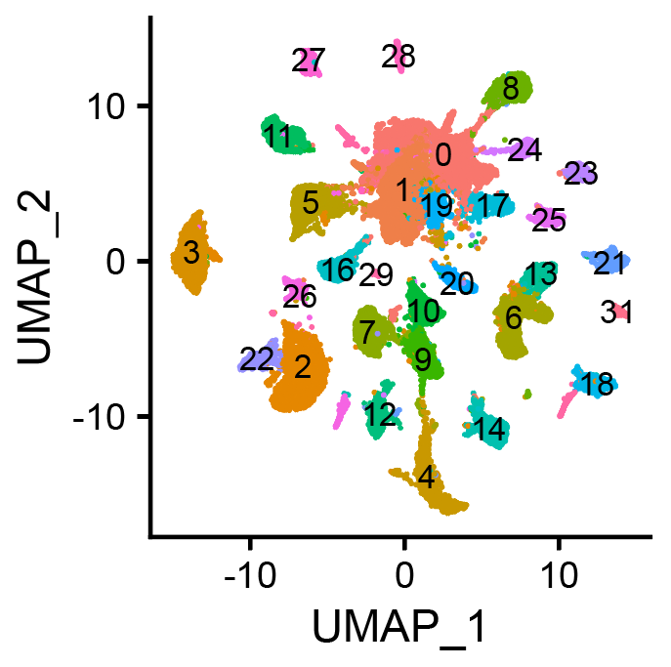
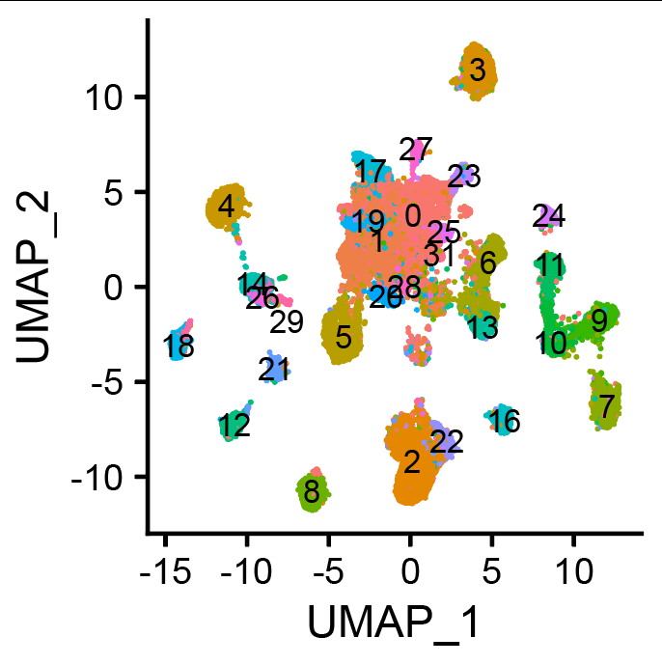
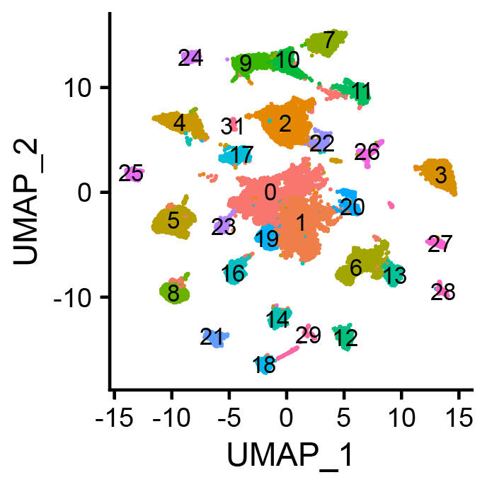
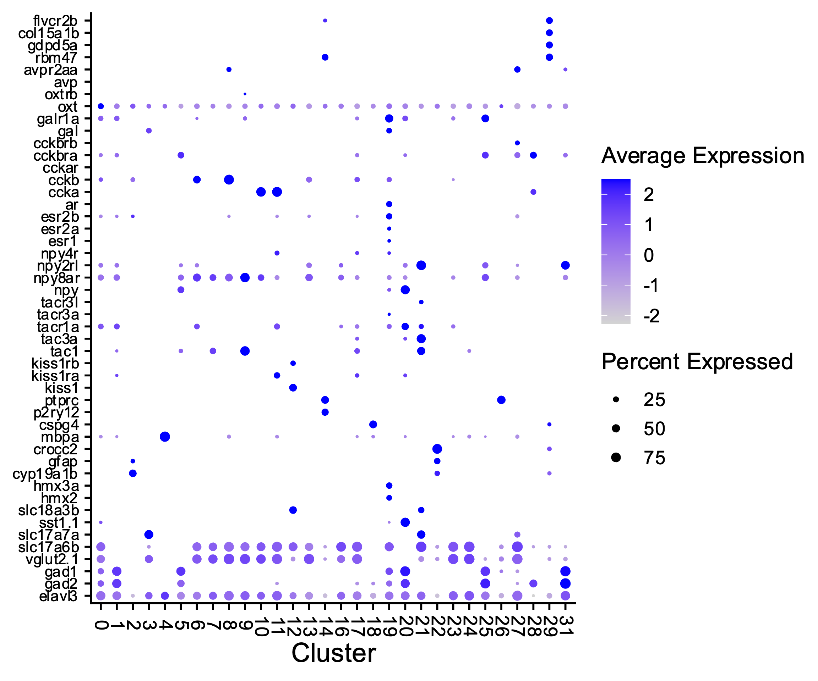
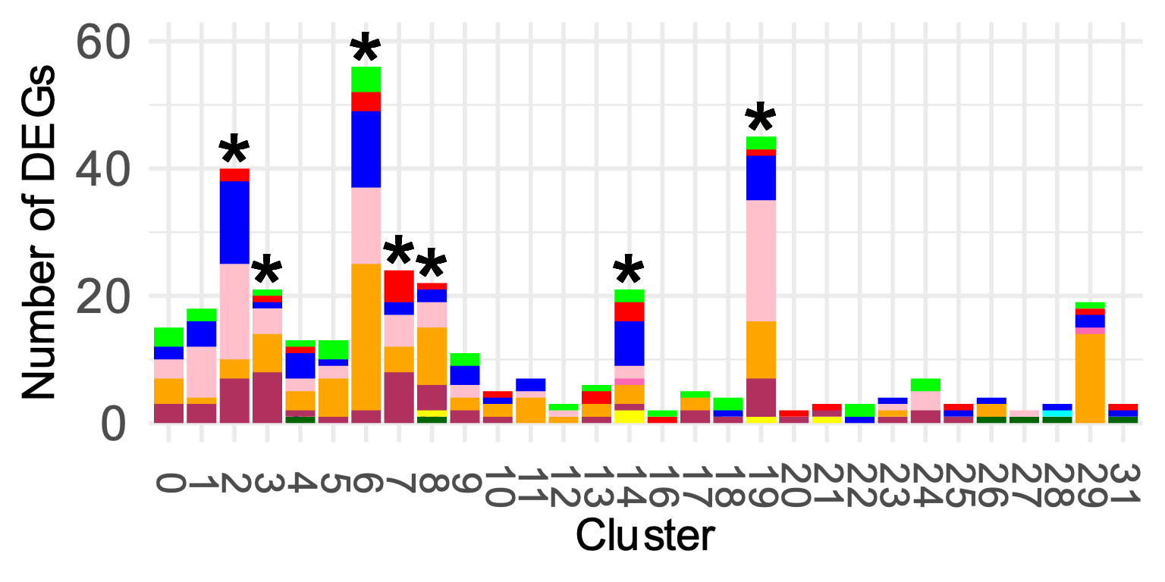
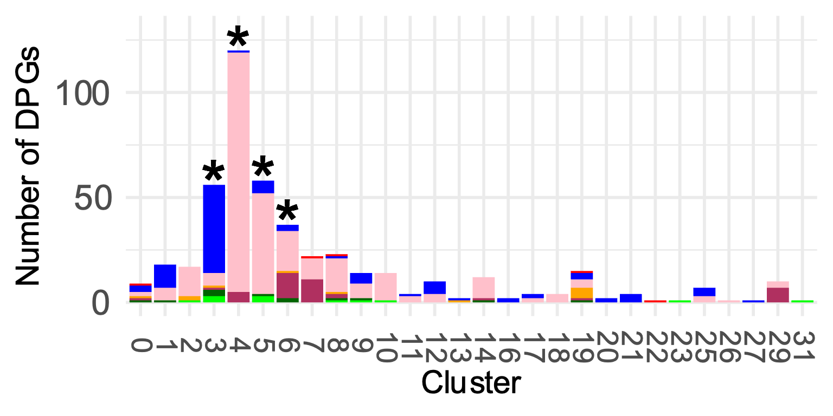
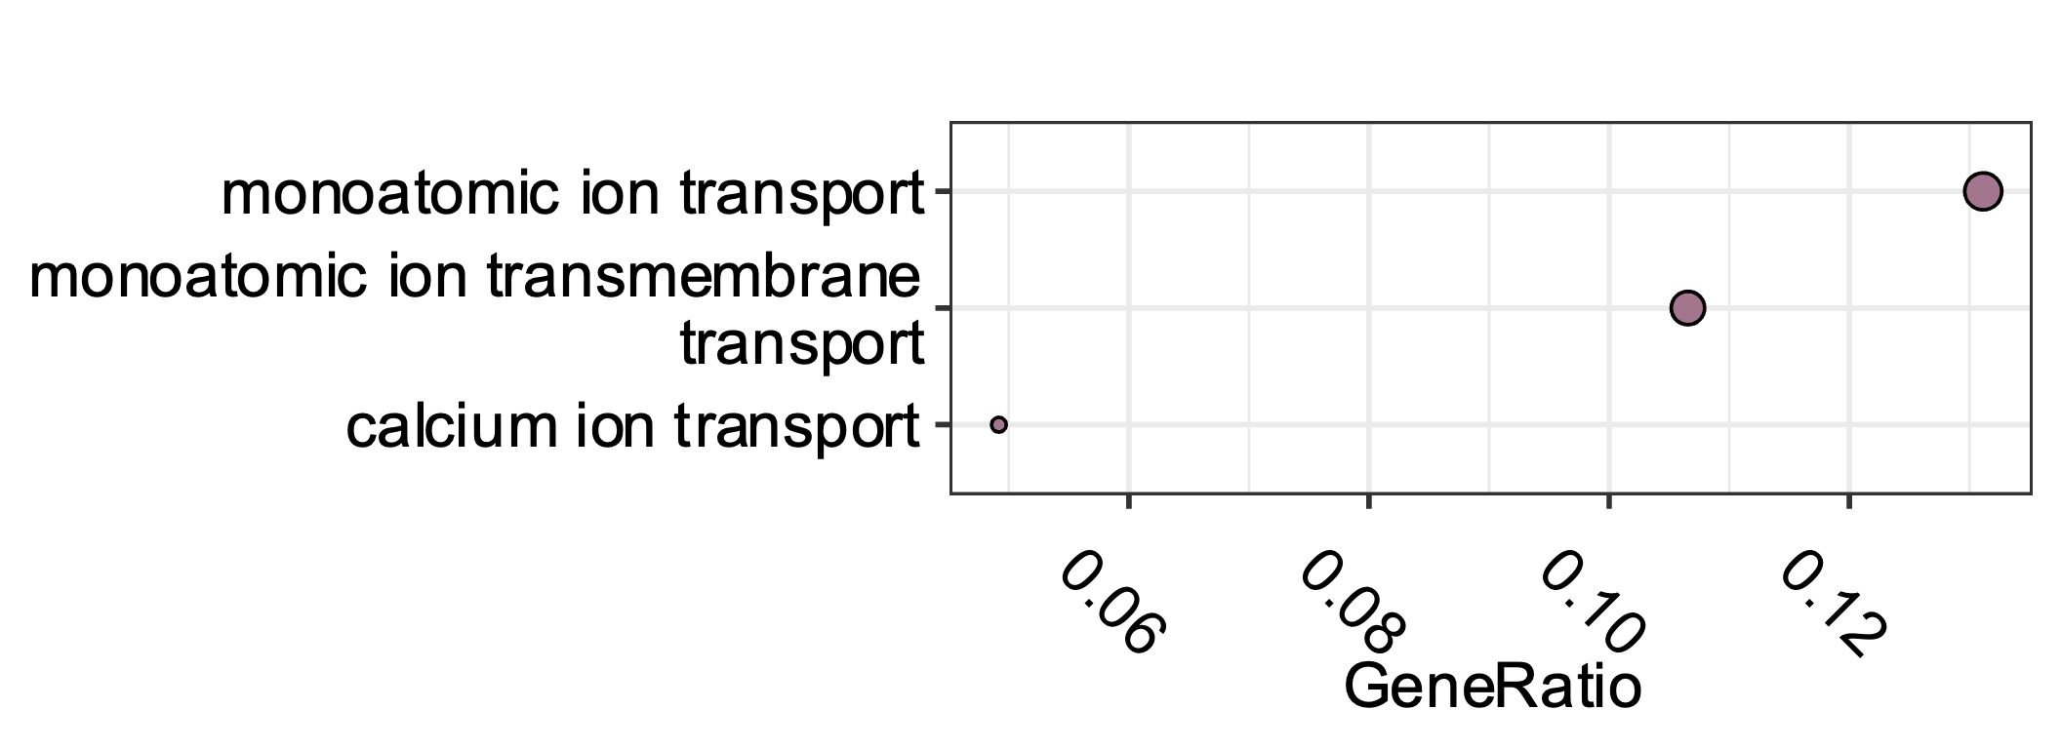
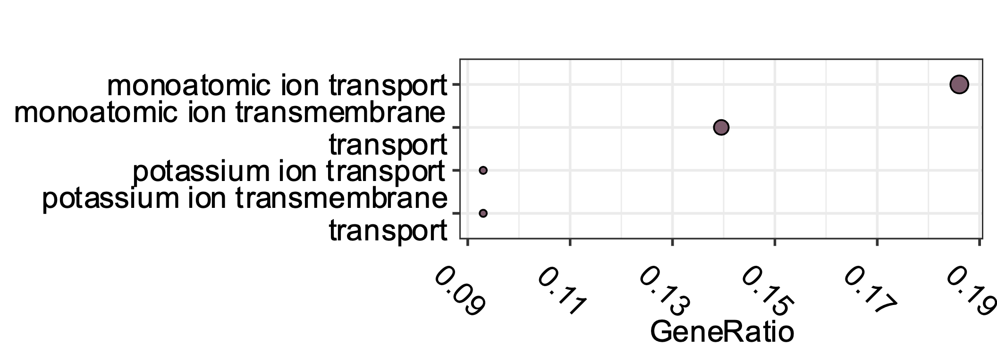
a
RNA
b
ATAC
c
RNA + ATAC
d
Fibroblast
Endothelial
Nonapeptide
Galanin
Cholecystokinin
Neuropeptides and Steroid Hormones
Steroid Hormones
Neuropeptide Y
Tachykinin
Kisspeptin
Immune
OPC
Glia
Oligodendrocyte
Ependymal Glia
Radial Glia
POA
Acetylcholine
Interneuron
Neuron
Glutamate
GABA
Neuron
e
f
Expression Pattern
g
h
monoatomic ion transport
monoatomic ion transport
monoatomic ion
transmembrane transport
monoatomic ion
transmembrane transport
calcium ion transport
potassium ion transport
potassium ion transmembrane transport

Slide 3
